Slide 1
SEIS 763 – Machine Learning Petfinder Project
Ke Chen
Jun Li
Jared Oeth
Satish Dandayudhapani

Slide 2

Introduction
Our project is to predict the rate at which a pet is adopted.
According to the rate which all the pets are adopted, like text, image data, we make prediction of how long animals can be adopted.

Slide 3
Dataset
Dataset is about of 2.7 GB of size and has 24 variables with a mix of continuous and categorical.
Data Fields
Class variable - Adoption Speed (0,1,2,3,4) – Classification
0 - Pet was adopted on the same day as it was listed.
1 - Pet was adopted between 1 and 7 days (1st week) after being listed.
2 - Pet was adopted between 8 and 30 days (1st month) after being listed.
3 - Pet was adopted between 31 and 90 days (2nd & 3rd month) after being listed.
4 - No adoption after 100 days of being listed. (There are no pets in this dataset that waited between 90 and 100 days)
Image Files - stored as separate JPGs with the petID
Sentiment Data - Each pet profile is run through Google’s Natural Language API, providing analysis on sentiment and key entities.

Slide 4
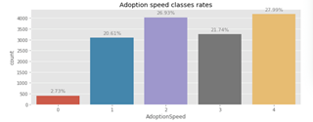
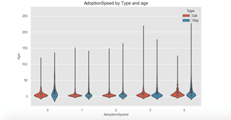
Data Exploration
26.93%
27.99%
A lot of pets aren't adopted at all, and we hope our models and analysis will help them to find their home. Most pets are adopted within the first month being listed.
Young pets are adopted quite fast.
20.61%
21.74%
2.73%
AdoptionSpeed
Age
AdoptionSpeed

Slide 5
Data Exploration
Base Rate (higher than base rate or lower than base rate):
We compare not only counts of pets in different categories, but also compare adoption speed rates with base rate.
This is an example of how the base rate was calculated:
The base rate of pets with adoption speed 0 is:
(# of pets with AdoptionSpeed = 0) / (Total # of pets)
= 410 / 14993 = 0.027;
There are 6861 cats in the train dataset and 240 of them have Adoption Speed 0, so the rate is
240 / 6861 = 0.035;
0.035/0.027 = 1.28, so by splitting out the data to cat vs dog, we can see that cats have a 28% increased chance of adoption speed class 0 over the base rate of adoption;

Slide 6
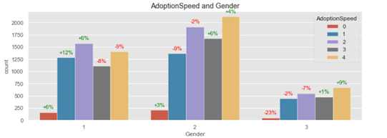
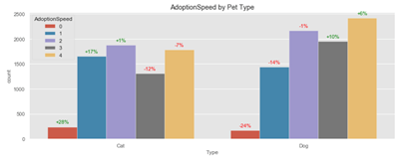
Gender
Type
Male pets (1) are adopted faster than female (2). Having no information about the gender (3) really decreases chances.
Cats are more likely to be adopted early than dogs and overall the percentage of not adopted cats is lower than that of dogs.

Slide 7
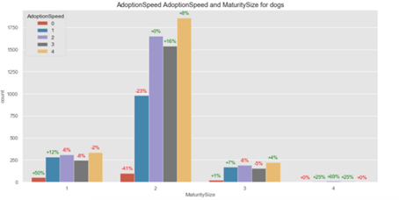
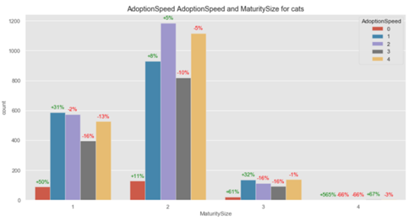
MaturitySize
MaturitySize
Medium sized pets (2) are most common, and they have slightly more chances to be not adopted. There are not many extra-large pets (4).

Slide 8
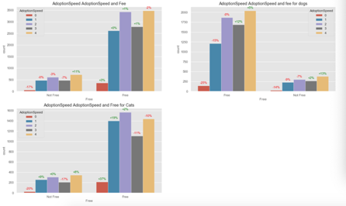
All Pets
Dogs
Pets with no fee are adopted faster.
Cats are adopted faster than dogs.
Not Free Free
Free Not Free
Not Free Free
Cats

Slide 9
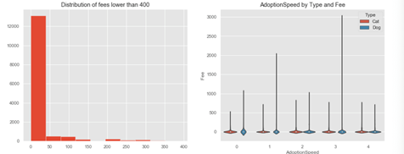
Count
fee
Fee
AdoptionSpeed
Most pets are free or lower than $50 to adopt and that the fee may decrease the chance of adoption.
Dogs are more expensive to adopt.

Slide 10
Preprocessing
CSV file with 14,993 pets
14,442 JSON files w/ Description Sentiment from Google Natural Language API
1 file per pet max
551 missing
58,311 jpg images
0-30 images per pet
341 missing

Slide 11
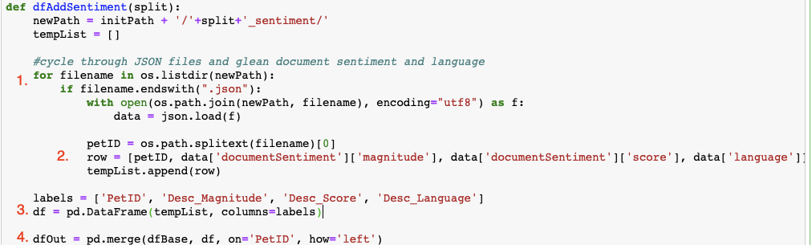
Preprocessing
Google Natural Language Results (JSON)
Use For-Loop and JSON package to run through each file in our folder
Extract dimensions from JSON file and add to python list
Append records into list that will be used in data frame
Join data frame with existing data
left outer because nulls exist, and we want to keep those pets in our model

Slide 12
Preprocessing
Feature Engineering - Images
Basic Image Statistics
Height & Width
Average, Median, Min, Max
Utilize For-Loop again to cycle through all files in image subfolder
Using Image package from Python Imaging Library (PIL), use the .size method to get height and width dimensions of each photo
Because one pet can have multiple photos, we used aggregate functions (min, max, mean, median) across the Pet ID
Create Data Frame one row per pet and join to base data again

Slide 13
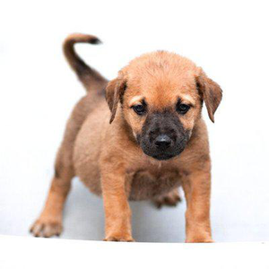
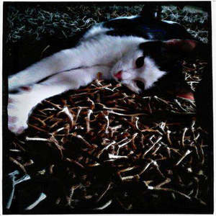
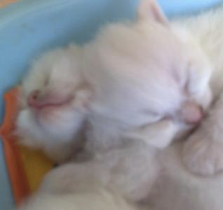
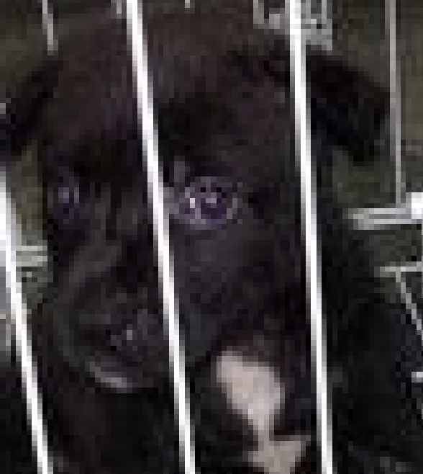
Preprocessing
Feature Engineering - Images
More Complex Metrics
Brightness (0-100)
Dullness (0-100)
Blurriness (5-16000)
Average Pixel Width (0-12)
Brightness: 96.84 Dullness: 91.525 Blurriness: 5.59 Avg. Pixel Width: 11.73

Slide 14
Preprocessing
Imputing and Encoding
Drop Pet ID, Description, and Rescuer ID
Impute Mean for numeric
Description Sentiment
Image dimensional and scoring features
Impute Mode for categorical
Description Language
Label Encoding and One Hot Encoding
Label Encode Description Language
One Hot Encode categorical columns

Slide 15
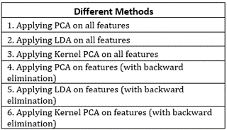
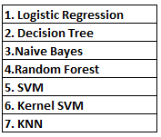
Methods
Algorithms
Accuracy Metrics
Classification Accuracy (Score)
Confusion Matrix
Algorithms - Models

Slide 16
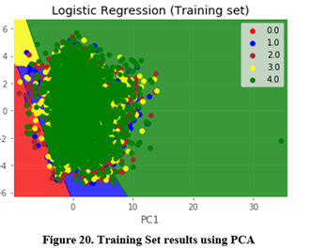
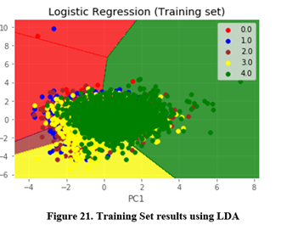
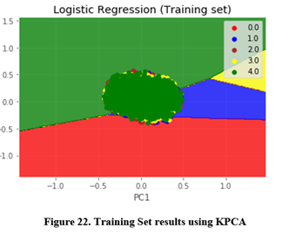
Visualizing PCA, LDA and KPCA where n_components =2
Algorithms - Models

Slide 17
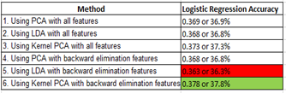

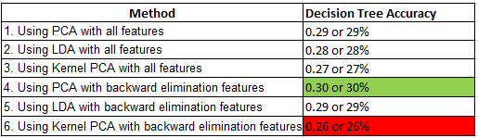
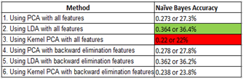
Results
Logistic Regression
Decision Tree
Naïve Bayes
Algorithms - Models

Slide 18
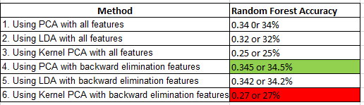
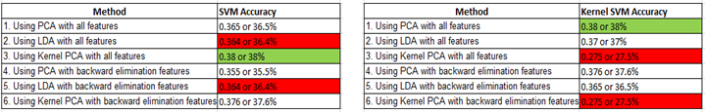
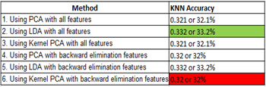
Results
Random Forest
Support Vector Machines (SVM) & Kernel SVM
K-Nearest Neighbors (KNN)
Algorithms - Models

Slide 19
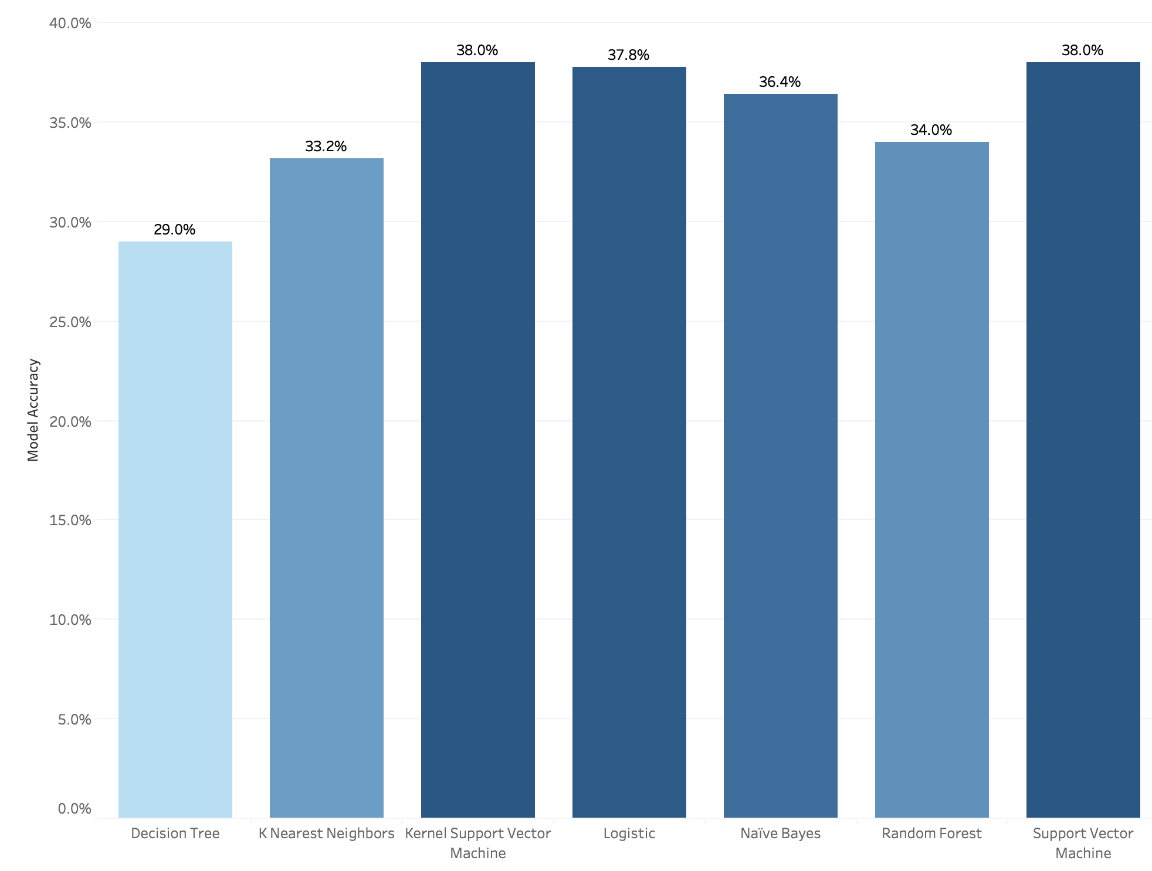
Conclusion
SVM turned out to be best algorithms for Petfinder dataset with 38% prediction accuracy.

Slide 20
Conclusion
SVM works well with clear margin of separation and is effective in high dimensional spaces.
But other model accuracies are close with SVM
Why such low accuracies?
Variety with in the feature i.e. Breed1, Breed2, Color1, Color 2, Color3 etc.
Target classes are overlapping

Slide 21
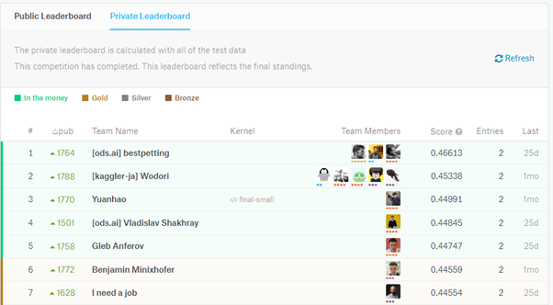
Conclusion
Comparing our results to Kaggle competition. Our model with 38% accuracy will be ~800 rank out of 1800
Future work –
Try different combinations of hyperparameters Grid Search, K-Fold and Pipeline.
Focus on the feature engineering to fine tune the models.
Try other boosting algorithms – XGBoost & Light GBM.

Slide 22
Questions
?

Slide 23
Thank You!

